Slide 1
IoT Byte-Sized: IoT Operations
WELCOME!
Allen R. Sanders
Senior Technology Instructor

Slide 2

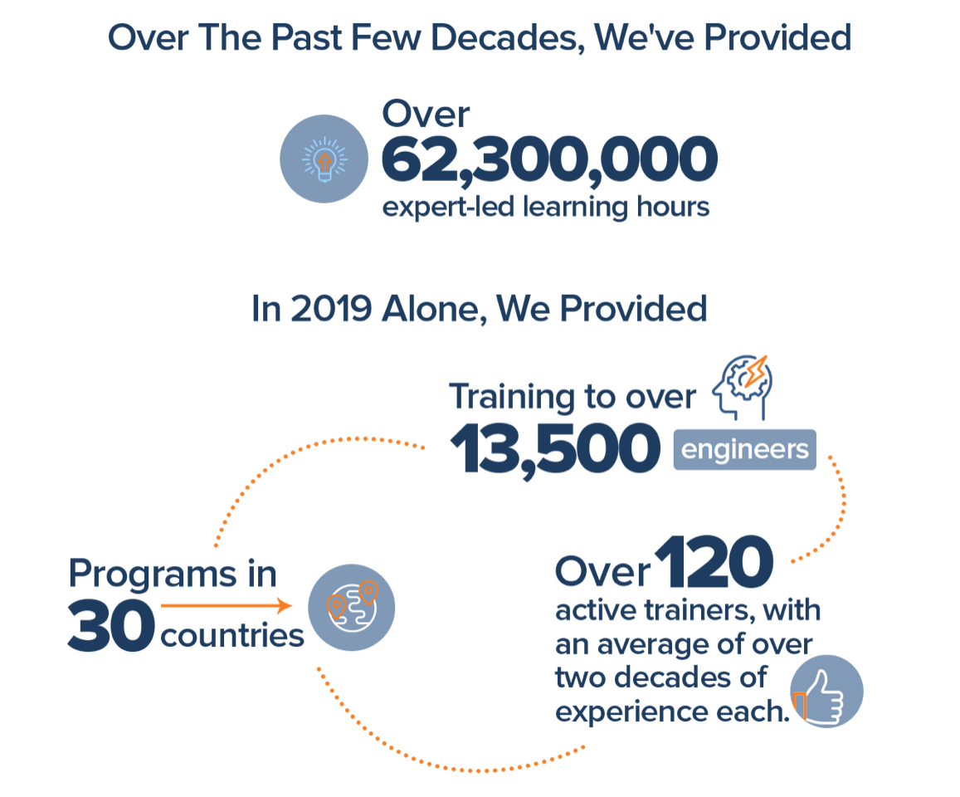
Join Us in Making Learning Technology Easier
Our mission…
Over 16 years ago, we embarked on a journey to improve the world by making learning technology easy and accessible to everyone.
…impacts everyone daily.
And it’s working. Today, we’re known for delivering customized tech learning programs that drive innovation and transform organizations. In fact, when you talk on the phone, watch a movie, connect with friends on social media, drive a car, fly on a plane, shop online, and order a latte with your mobile app, you are experiencing the impact of our solutions.
Copyright DevelopIntelligence LLC
Notes:
ACTION: Share a bit about DevelopIntelligence
- As developers you want to learn!
- As a corporation you want your developers to align their learning with your business goals.
- That’s where we come in… Keeping developers current, bringing others up-to-speed … all aimed at moving your business forward!
- DI was started in 2003 by a Sun Microsystems developer that wanted to help developers level-up and see business better leverage IT

Slide 3
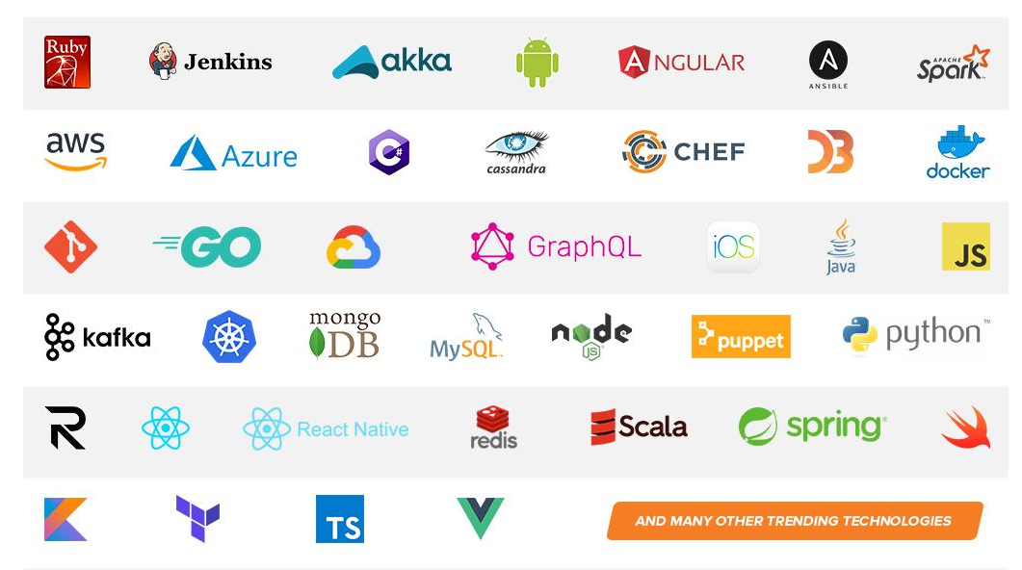
Technologies we cover
Notes:
ACTION: Share some of the technologies we teach
Areas of DevelopIntelligence expertise
DevOps: Ansible / Jenkins
BigData: Hadoop / Cassandra / Spark
Machine Learning
Front-end: React / Angular
Cloud: AWS / Azure / Google Cloud
- Started as a Java shop -> kept growing -> haven’t looked back
- Our specialty is hiring expert practitioners that can come alongside teams and teach them how to move forward

Slide 4
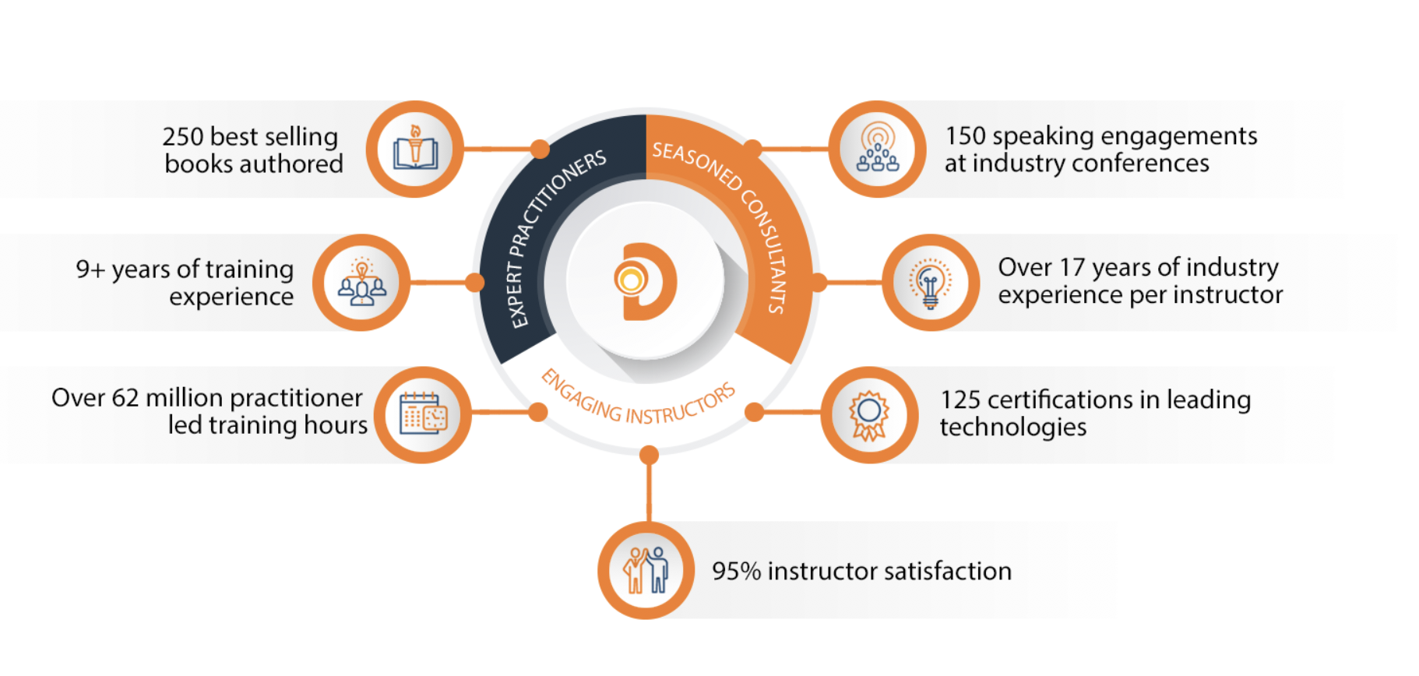
World Class Practitioners
Notes:
ACTION: Share about what makes the DevelopIntelligence instructor team one of-a-kind!
Here is some data showing instructors are expert practitioners, engaging instructors, seasoned consultants. We are the best in the business!

Slide 5



Virtual Training Expectations for You
Arrive on time / return on time Mute unless speaking Use chat or ask
questions verbally
Notes:
ACTION: Share the expectations you have for the students
Level set the rules of engagement for virtual classrooms. Encourage students to be on time! Just because this is a virtual class doesn’t mean it’s ok to inconvenience peers who showed up on time.
Mute yourself unless asking a question/commenting
Ask questions (verbally or via chat window)

Slide 6
Virtual Training Expectations for Me
I pledge to:
Make this as interesting and interactive as possible
Ask questions in order to stimulate discussion
Use whatever resources I have at hand to explain the material
Try my best to manage verbal responses so that everyone who wants to speak can do so
Quick review of key Zoom features that may be helpful for our course
Notes:
ACTION: Share the expectations the students should have for you
Level set to the students what they can expect from you. Instructor will do the best to mix it up…
Zoom tools, hands-on, breaks, group work, break out rooms… keep it interesting and interactive

Slide 7
Purpose
Gain a deeper understanding of operating IoT initiatives at scale

Slide 8
Objectives
Upon completion of this course, you should be able to:
List the common metrics for IoT and how they are measured and assessed
Describe how to achieve performance at scale
List some business-centric strategies for scaling IoT
Explain how DevOps and DevSecOps fit into the IoT operations

Slide 9
Introduction

Slide 10
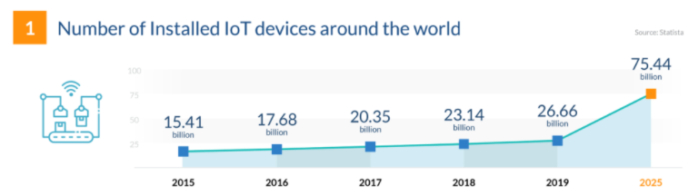
Industry Trends
From https://financesonline.com/iot-trends
Challenges potentially encountered with that amount of projected growth?

Slide 11
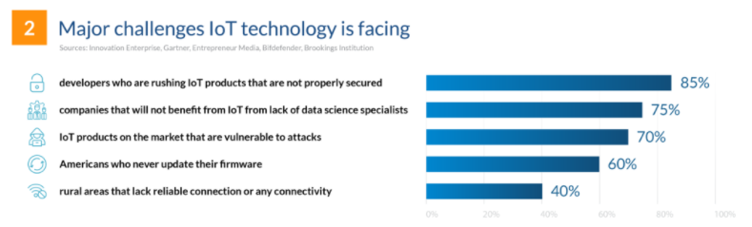
Industry Trends
From https://financesonline.com/iot-trends
Options for mitigating those challenges?

Slide 12
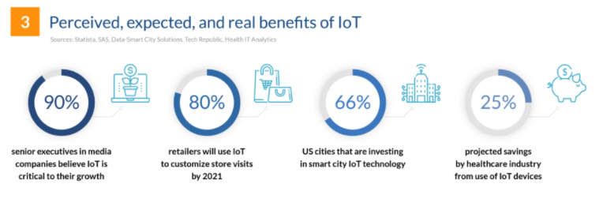
Industry Trends
From https://financesonline.com/iot-trends
How do we help customers realize those benefits?

Slide 13
Industry Trends
Areas of focus:
Accommodating orders of magnitude of growth
Preventing known (or unknown) challenges from impeding success
As a business, effectively leveraging opportunities to meet customer needs
Device Management
Leveraging the Edge
Data Management

Slide 14
Operations

Slide 15

Metrics, Measurement & Assessment
“Every line is the perfect length if you don’t measure it.”
- Marty Rubin
“What gets measured gets managed.”
- Pearl Zhu
“If you don’t collect any metrics, you’re flying blind. If you collect and focus on too many, they may be obstructing your field of view.”
- Scott M. Graffius
“What science has failed to notice is that the measurement has become more real than the thing being measured.”
- R.A. Delmonico

Slide 16
Metrics, Measurement & Assessment
“That which cannot be measured cannot be proven.”
- Anthony W. Richardson
“All conflict in the world is essentially about our differences in measurement.”
- Joseph Rain
“It is impossible to escape the impression that people commonly use false standards of measurement – that they seek power, success and wealth for themselves and admire them in others, and that they underestimate what is of true value in life.”
- Sigmund Freud

Slide 17
Metrics, Measurement & Assessment
“Too many organizations treat [IoT] as a technology project, as opposed to what it really is, which is a business transformation project using technology. First rule of IoT club: Don't talk about IoT. Talk about business using IoT.”
-Alfonso Velosa, research vice president and analyst for IoT at Gartner

Slide 18
Performance at Scale
Depending on application, volume of devices & data could be significant
As discussed, requires management at scale on multiple levels:
Device management
Software management
Data management

Slide 19
Performance at Scale
Execution for a small number of devices is more straightforward
Execution for thousands or tens of thousands of devices is a different story
With that volume, requires a much different approach

Slide 20

Strategies for Scaling IoT
Set a clear business objective
Business goals should drive technology for IoT
Evaluate whether (or not) adding/enhancing IoT can make the company more successful
Enables the correlation of scaling tasks (and any “bumps”) to value

Slide 21
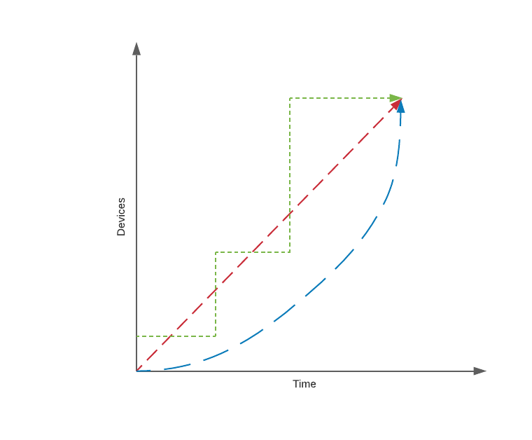
Strategies for Scaling IoT
Start small and build up
Trial run with smaller sets of devices can help confirm configuration
Each new set of “onboarded” devices should have metrics for success and ROI
Allows for correction (if needed) as you go (Agile)

Slide 22

Strategies for Scaling IoT
Create a specialized team or CoE (Center of Excellence)
Organize a group to manage IoT priorities and curate best practices
Needs to include senior management buy-in and participation
Build continuous improvement into the DNA

Slide 23

Strategies for Scaling IoT
Understand and assess maturity
Honestly and objectively assess progress of status against targets
Identify next level(s) of maturity and steps required to achieve
There is no standing still – technology efforts progress or regress

Slide 24
DevOps & Automation
As with other software applications, DevOps can provide lift
Key principle of DevOps is automation
Continuous Integration & Continuous Delivery can be applied to Edge/IoT as well

Slide 25
DevOps & Automation
Presents opportunities to apply scripting to:
Automate onboarding, offboarding, and configuration of devices
Deployment & configuration of Edge components
Deployment & configuration of Cloud services used to aggregate & analyze data
Practicing principles of DevSecOps helps ensure security is “shifted left”

Slide 26
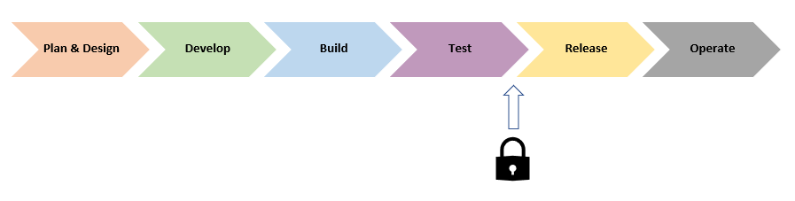
DevOps & Automation
What is often done:
What are the potential challenges with taking this approach?

Slide 27
DevOps & Automation
Potential challenges:
At this point, there may not be enough time in schedule to absorb change
Activities required to remediate may be complex
May require revisit of one or more previous phases to properly address

Slide 28
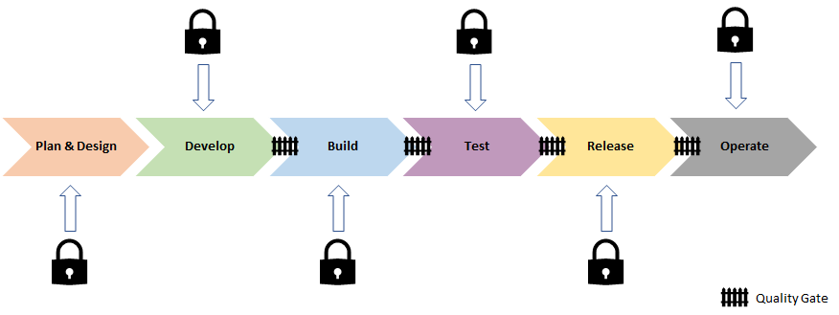
DevOps & Automation
Better approach:

Slide 29
DevOps & Automation
Plan & Design – Threat modeling, data protection, and risk assessment
Develop – SAST (Static Application Security Testing) tools
Build – SAST and SCA (Software Composition Analysis) tooling
Test – DAST (Dynamic Application Security Testing) tools, passive/active scans and “fuzzing”
Release – Additional security-specific scanning, port scans, and log validation
Operate – Monitoring & alerting, RCA (Root Cause Analysis)

Slide 30
DevOps & Automation
Quality gates guard against moving security defects forward
In true DevOps fashion:
Information gathered from early phases feeds into later phases
Lessons learned feed continuous improvement of overall process

Slide 31
Data Visualization & Dashboarding
Computers are great at “crunching” large amounts of raw data
For humans, sometimes a “picture is worth a million bytes”
With dashboarding & graphical visualization, it can be much easier to see trends
Data science and forecasting can help with extrapolating for the future

Slide 32
Data Visualization & Dashboarding
Tools like Power BI or Tableau (among others) provide powerful options
Able to integrate through connectors with multiple data sources
Visualizations & charts can be layered onto large datasets to provide insight

Slide 33
Data Visualization & Dashboarding
Often the tools support regular data refresh for fuller picture over time
Tools leverage defined authentication/authorization against data sources
Helps ensure ongoing, end-to-end security of key data

Slide 34

IT & OT Convergence
IT/OT is the convergence of:
Information Technology (IT)
Operational Technology (OT)
Important to understand distinction (and overlap) from an operational perspective

Slide 35
IT & OT Convergence
Broadly speaking:
IT – use of technology/process to create, store, secure, and exchange electronic data
OT – traditionally associated with monitoring events, processes, and devices as part of enterprise and industrial operations management

Slide 36
IT & OT Convergence
OT considerations:
Includes ICS (Industrial Control Systems) and SCADA (Supervisory Control and Data Acquisition)
Not traditionally networked technology (i.e., WAN or Internet)
Often use closed, proprietary protocols and lower-level embedded tech
Security requirements traditionally different due to how connected

Slide 37

Types of Convergence
Process convergence
Software and data convergence
Physical convergence

Slide 38
Process Convergence
Convergence of IT & OT workflows
Process reform so each can benefit from the other
Can require organizational change (sometimes significant) to achieve

Slide 39
Software and Data Convergence
Technical convergence at the software and data layers
Can include unification of disparate IT or OT protocols toward standardization
Separate, siloed data stores need to converge to provide comprehensive visibility

Slide 40
Physical Convergence
Includes hardware convergence (or retrofit) to unify
Depending on size of gap, may mean replacement rather than upgrade
Often required to fully enable software and data convergence

Slide 41
IT/OT Convergence at the Edge
The Edge can assist with convergence:
Bridging the gaps during transition (e.g., at the network layer)
What lacks in unified software or hardware may be mitigated (at least temporarily) with the intelligent Edge
Any changes that cannot be implemented (due to cost constraints) can be abstracted at the Edge

Slide 42
IT/OT Convergence – Benefits
Less siloed IT and OT departments
Reduced development and support costs (e.g., predictive maintenance)
Faster time to market for converged tech
More efficient energy/resource usage

Slide 43
IT/OT Convergence – Benefits
Improved compliance with regulatory standards (via modernization)
Improved automation for older, proprietary OT devices
Improved visibility through expanded real-time data reporting
More efficient asset management (1 stream instead of 2)

Slide 44
IT/OT Convergence – Challenges
Requires organizational change which can be significant and difficult
Modernizing and improving security might be impeded by existing tech or lack of knowledge
Reskilling through training can be a challenge to coordinate and execute
Integration of siloed areas can have multiple, hidden issues

Slide 45
Absorbing Enhancements
As with all other technology types, Edge/IoT is ever-evolving
Enhancements are likely to occur in multiple areas:
Communication protocols
Device hardware and software
Edge hardware and software
Cloud services

Slide 46
Absorbing Enhancements
A company’s Edge/IoT strategy must be able to embrace the change
Otherwise, run the risk of missing out on advancements & new capabilities
Must be able to balance orderly absorption of change against volume

Slide 47
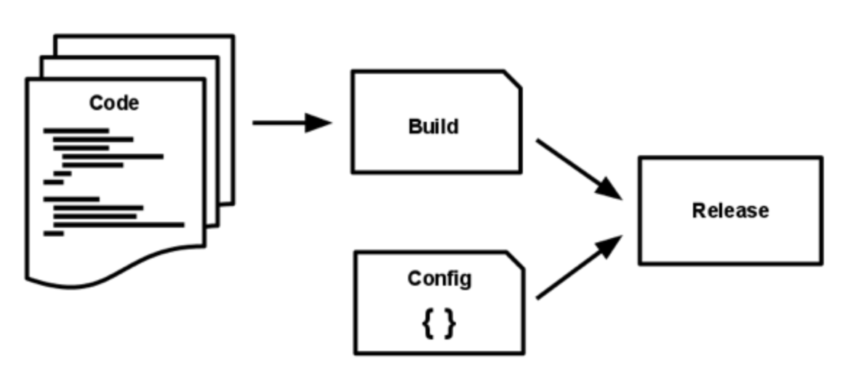
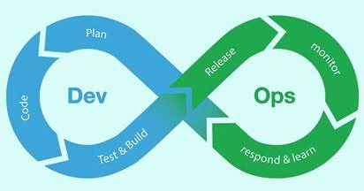
Absorbing Enhancements
Requires intermediate environments within DevOps pipeline
Need a way to test the enhancements to verify and help avoid regression
Additionally, provides mechanism for validating deployment of change at scale

Slide 48
Absorbing Enhancements
In some cases, update may not suffice
Some enhancements will require replacement to realize benefits
DevOps & asset management strategy must be able to support structured approach to upgrades (both hardware & software)

Slide 49
Scale
Scenario: A manufacturing company has been piloting a small set of sensors (50) in one of their US locations for monitoring status and any operational anomalies for manufacturing equipment. The pilot effort has proven to be very successful and senior leadership would now like to extend the use of the IoT solution to all US locations (27 locations and 17K pieces of manufacturing equipment) over the course of the next year. The following year, leadership would like to extend the technology to global reach which would include an additional 52 international factories and 46K pieces of manufacturing equipment.
If your team was charged with implementing the goals outlined in the scenario, what kinds of questions might you ask to gain important requirements detail?
What kinds of operational challenges might you face in attempting to implement (People, Process, and Technology)?
What kinds of challenges might you face in attempting to support?

Slide 50
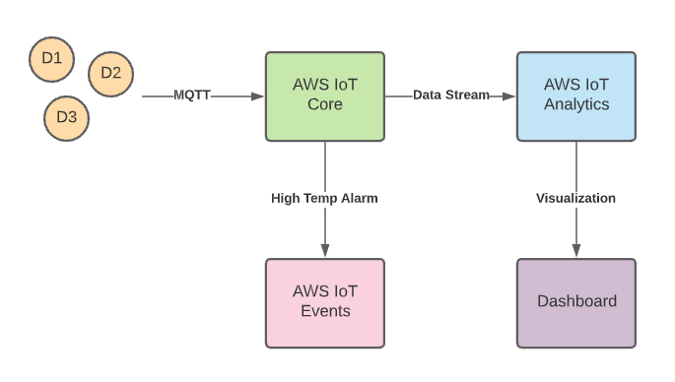
Demo

Slide 51
THANK YOU

